Slide 1

More on Hardware Design
7

Slide 2
Design Process Flow
Data flow
  Signal flow graph (SFG)
  Functional
  Procedural languages
Control flow
  FSM
  Procedural languages
Behavior
description
Constraints
Allocation
Assignment
Pipeline
retiming
Mapping /
Optimization
Cost function
Implementation
Notes:
Note 2-<number>
EE4202 Computer Architecture
A/P Tay Teng Tiow, EE, NUS, 20012002

Slide 3
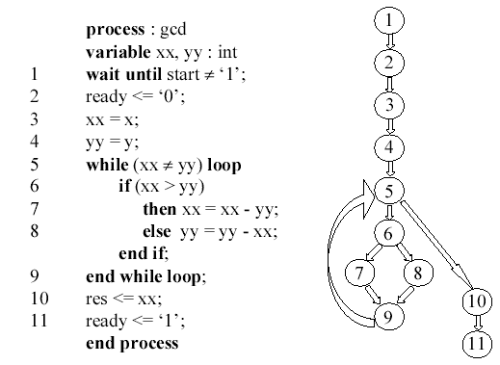
Example: Synthesis with Control Flow
Follows flow
of program
Notes:
Note 2-<number>
EE4202 Computer Architecture
A/P Tay Teng Tiow, EE, NUS, 20012002

Slide 4
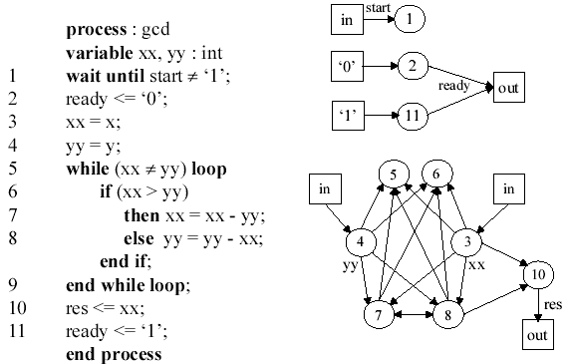
Example: Synthesis
with Data Flow
Availability of data
No concept of state
Notes:
Note 2-<number>
EE4202 Computer Architecture
A/P Tay Teng Tiow, EE, NUS, 20012002

Slide 5
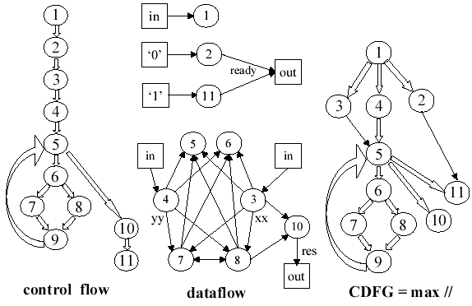
Example:
Synthesis with CDFG
Combine dataflow and control
flow give maximum freedom
for the synthesis.
Notes:
Note 2-<number>
EE4202 Computer Architecture
A/P Tay Teng Tiow, EE, NUS, 20012002

Slide 6
From specification to architectures
Allocation
  How many module of each type
Assignment
  Which module to go to which node
Retiming / scheduling
  When the operations will be executed
Notes:
Note 2-<number>
EE4202 Computer Architecture
A/P Tay Teng Tiow, EE, NUS, 20012002

Slide 7
Three possibilities
One-to-one mapping
Function multiplexing
Time folding
Notes:
Note 2-<number>
EE4202 Computer Architecture
A/P Tay Teng Tiow, EE, NUS, 20012002

Slide 8
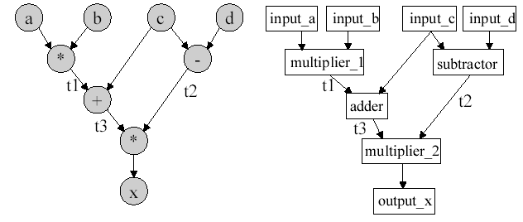
One-to-one mapping
Every node allocate
a module.
Notes:
Note 2-<number>
EE4202 Computer Architecture
A/P Tay Teng Tiow, EE, NUS, 20012002

Slide 9
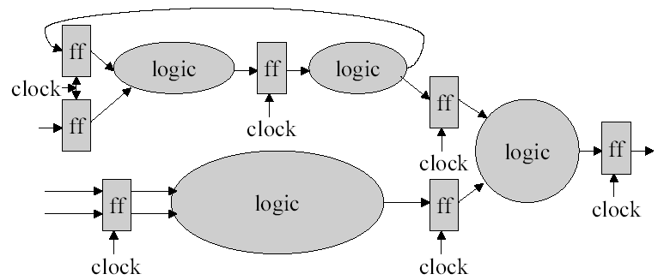
Synchronous timing analysis
Results latch in at clock.
Logic must finish in 1 clock cycle,
determine maximum clock speed
  F/F in between logic blocks
Notes:
Note 2-<number>
EE4202 Computer Architecture
A/P Tay Teng Tiow, EE, NUS, 20012002

Slide 10
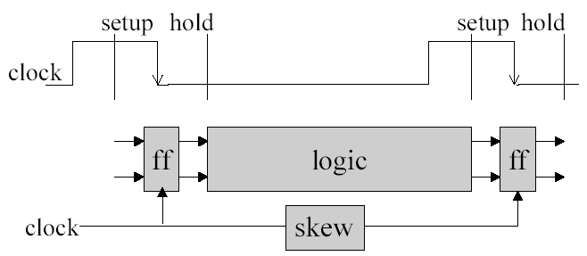
Determining clock speed
Cycle_time = clock_to_Q + longest_logic_path + setup + clock+skew
Clock_to_Q + shortest_logic_path – clock_skew > hold
Notes:
Note 2-<number>
EE4202 Computer Architecture
A/P Tay Teng Tiow, EE, NUS, 20012002

Slide 11
Timing requirement
Does clock rate meets frame to frame computational requirement?
  Yes ➔ Done
  No
    Pipeline
    Re-timing
Notes:
Note 2-<number>
EE4202 Computer Architecture
A/P Tay Teng Tiow, EE, NUS, 20012002

Slide 12
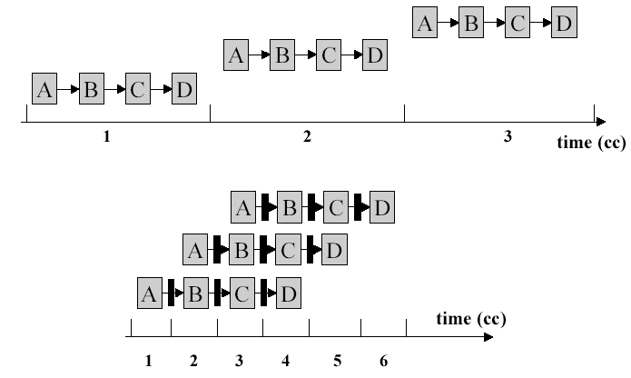
Sequential operations.
What is Pipelining?
Breaking into phases. Perform different phases concurrently.
Notes:
Note 2-<number>
EE4202 Computer Architecture
A/P Tay Teng Tiow, EE, NUS, 20012002

Slide 13
How to create a pipeline?
Starting with:
Assume that at each clock, X process data at input F/F
data
Logic Block X
clk
Suppose X=A+B+C+D
data
Logic A
Logic B
Logic C
Logic D
clk
Introduce 3 F/F at input ➔ 3 clock cycles delay
data
Logic A
Logic B
Logic C
Logic D
clk
Notes:
Note 2-<number>
EE4202 Computer Architecture
A/P Tay Teng Tiow, EE, NUS, 20012002

Slide 14
How to create a pipeline?
Re-distribute the F/F to be in-between logic blocks
data
Logic A
Logic B
Logic C
Logic D
clk
At each clock cycle, the results of each logic block is latched into F/F
At steady state, logic A would be computing data of time k, logic B would be
computing data of time k-1, logic C would be computing data of time k-2,…
The computation delays of logic A, B, C and D equal that of X. If delays
of A,B,C and D are equal, then you can theoretically increase clock
frequency to 4 times.
Data at the input would appear 3 clock cycles later than the non-pipeline
case. Note that clock is now faster.
Notes:
Note 2-<number>
EE4202 Computer Architecture
A/P Tay Teng Tiow, EE, NUS, 20012002

Slide 15
What is re-timing?
From previous slides
  X=A+B+C+D, where each represents computational delay
  If A=B=C=D, then clock frequency can be increase by 4 times
  If not equal, then clock frequency is limited by the worst delay value.
    Eg if A=3B=3C=3D, then clock period at best is 3/(3+1+1+1)=0.5 of old clock period. Therefore clock frequency is at most 2 times.
Re-timing is re-distributing of delays of each phase so that delays are equalized in all phases.
  Thereby giving maximum clock frequency increase
Notes:
Note 2-<number>
EE4202 Computer Architecture
A/P Tay Teng Tiow, EE, NUS, 20012002

Slide 16
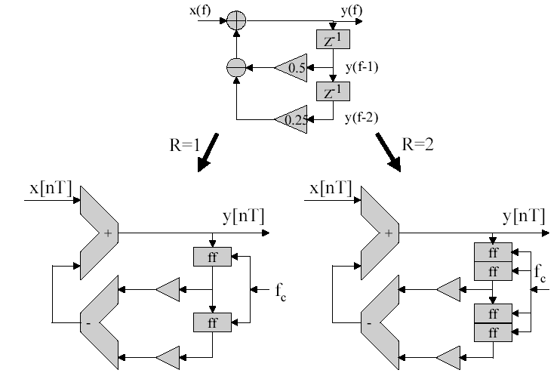
Mapping SFG delays
Z⁻¹ equivalent to a sample
delay.
Each f/f equivalent to
a clock delay
R = f_clock / f_sample
One delay = 1 f/f
One sample delay = 2 f/f
Notes:
Note 2-<number>
EE4202 Computer Architecture
A/P Tay Teng Tiow, EE, NUS, 20012002

Slide 17
In perspective
Each z⁻¹ in the SFG is a delay at the sampling frequency (of the underlying analog circuit).
  Cannot insert z⁻¹ indiscriminately as it destroys the dynamics of the underlying system.
Every implemented F/F is equivalent to a delay in computation of the SFG at the clock frequency.
  Can insert F/F at will if there is no feedback loop
    An extra n F/F inserted is equivalent to the forward chain computation complete in (1+n) instead of 1 clock cycle.
Each z⁻¹ may be implemented by 1 or more F/F.
F/F may be re-distributed forward or backward.
Notes:
Note 2-<number>
EE4202 Computer Architecture
A/P Tay Teng Tiow, EE, NUS, 20012002

Slide 18
In perspective
Cannot add F/F indiscriminately within a loop. WHY ?
  A sample delay z⁻¹ is implemented as n F/F or n clock delays.
  All z⁻¹ are implemented as n clock delays
  If one of the loop has extra F/F inserted, the output feedback to the input will be at the wrong time !
Notes:
Note 2-<number>
EE4202 Computer Architecture
A/P Tay Teng Tiow, EE, NUS, 20012002

Slide 19
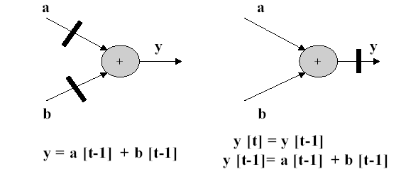
Distributing delays
The results of these two implementations are equivalence.
However the time where the bulk of the computational delays
occur is different.
Note that the number of F/F needed is different
Notes:
Note 2-<number>
EE4202 Computer Architecture
A/P Tay Teng Tiow, EE, NUS, 20012002

Slide 20
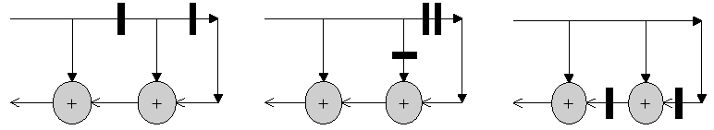
Redistributing delays / Re-timing
Y(k)=U(k)+U(k-1)+U(k-2)
Delays
Virtually nothing to do
U(k)
U(k-1)
U(k)
U(k)
Y(k)
Y(k)
Y(k)
2 additions to be completed
within a clock cycle
Notes:
Note 2-<number>
EE4202 Computer Architecture
A/P Tay Teng Tiow, EE, NUS, 20012002

Slide 21
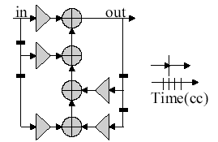
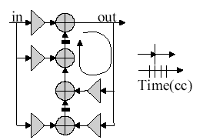
Example: Re-timing
Move delays forward … Can you see how?
Notes:
Note 2-<number>
EE4202 Computer Architecture
A/P Tay Teng Tiow, EE, NUS, 20012002

Slide 22
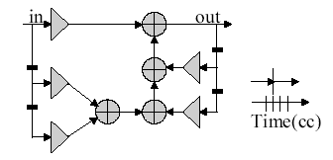
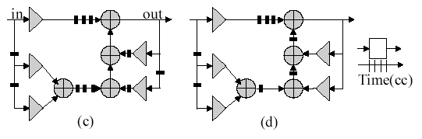
Ex: Pipelining and then retiming
Add 3 F/F at the input and
then move F/F forward.
Note: re-timing cannot change the number of f/f in a loop
Notes:
Note 2-<number>
EE4202 Computer Architecture
A/P Tay Teng Tiow, EE, NUS, 20012002

Slide 23
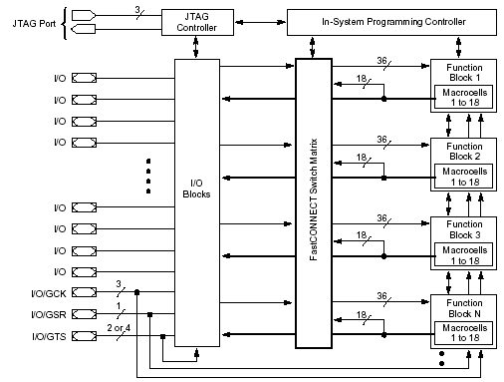
Xilinx
XC95108
In-System Programmable CPLD
Notes:
Note 2-<number>
EE4202 Computer Architecture
A/P Tay Teng Tiow, EE, NUS, 20012002

Slide 24
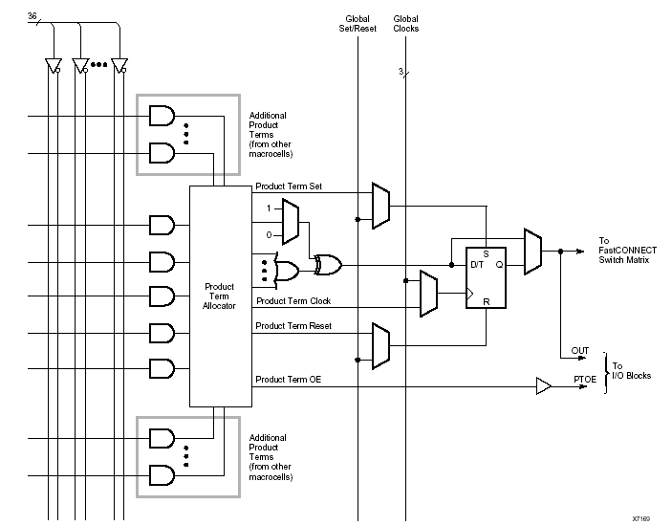
XC9500 Macrocells
Notes:
Note 2-<number>
EE4202 Computer Architecture
A/P Tay Teng Tiow, EE, NUS, 20012002

Slide 25
Three possibilities
One-to-one mapping
Function multiplexing
Time folding
Notes:
Note 2-<number>
EE4202 Computer Architecture
A/P Tay Teng Tiow, EE, NUS, 20012002

Slide 26
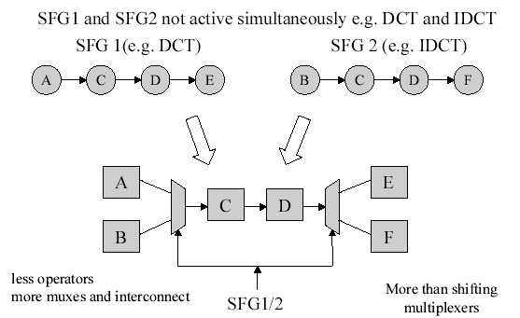
Function Multiplexing
SFG1
SFG2
Notes:
Note 2-<number>
EE4202 Computer Architecture
A/P Tay Teng Tiow, EE, NUS, 20012002

Slide 27
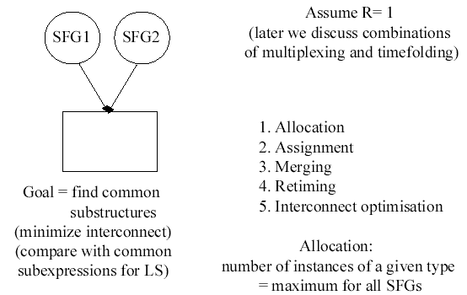
Function Multiplexing
Notes:
Note 2-<number>
EE4202 Computer Architecture
A/P Tay Teng Tiow, EE, NUS, 20012002

Slide 28
Three possibilities
One-to-one mapping
Function multiplexing
Time folding
Notes:
Note 2-<number>
EE4202 Computer Architecture
A/P Tay Teng Tiow, EE, NUS, 20012002

Slide 29
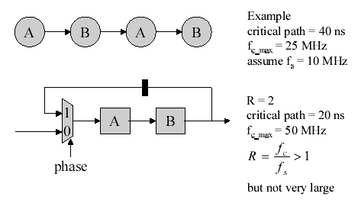
Time sharing
When operating frequency is low
Hardware utilization rate is low
Reduce hardware and share modules
Requires 2A and 2B
Use multiplexer to schedule one set of A and B
Notes:
Note 2-<number>
EE4202 Computer Architecture
A/P Tay Teng Tiow, EE, NUS, 20012002

Slide 30
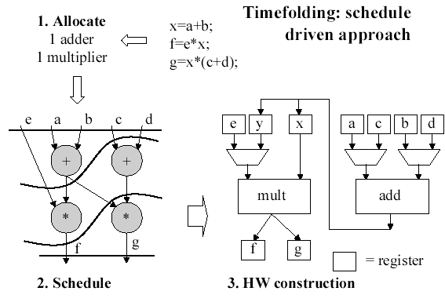
A schedule driven approach
1
2
3
Notes:
Note 2-<number>
EE4202 Computer Architecture
A/P Tay Teng Tiow, EE, NUS, 20012002

Slide 31
Asynchronous Design
Notes:
Note 2-<number>
EE4202 Computer Architecture
A/P Tay Teng Tiow, EE, NUS, 20012002

Slide 32
Advantages of Asynchronous Design
No clock skew
  Difference in arrival times of clock at different parts of circuit.
  Asynchronous circuits by definition have no globally distributed clock,
  Synchronous systems often slow down their circuits to accommodate the skew.
  As feature sizes decrease, clock skew becomes a much greater concern.
Notes:
Note 2-<number>
EE4202 Computer Architecture
A/P Tay Teng Tiow, EE, NUS, 20012002

Slide 33
Advantages of Asynchronous Design
Lower power
  Standard synchronous circuits have to toggle clock lines, and possibly pre-charge and discharge signals, in portions of a circuit unused in the current computation.
    For example, even though a floating point unit on a processor might not be used in a given instruction stream, the unit still must be operated by the clock.
  Although asynchronous circuits often require more transitions on the computation path than synchronous circuits, they generally have transitions only in areas involved in the current computation.
    Note that there are techniques being used in synchronous designs to address this issue as well.
Notes:
Note 2-<number>
EE4202 Computer Architecture
A/P Tay Teng Tiow, EE, NUS, 20012002

Slide 34
Advantages of Asynchronous Design
Average-case instead of worst-case performance
  Synchronous circuits must wait until all possible computations have completed before latching the results
  Many asynchronous systems sense when a computation has completed, allowing them to exhibit average-case performance.
  For circuits such as ripple-carry adders where the worst-case delay is significantly worse than the average-case delay, this can result in a substantial savings.
Notes:
Note 2-<number>
EE4202 Computer Architecture
A/P Tay Teng Tiow, EE, NUS, 20012002

Slide 35
Advantages of Asynchronous Design
Easing of global timing issues
  In systems such as a synchronous microprocessor, the system clock, and thus system performance, is dictated by the slowest (critical) path.
  Most portions of a circuit must be carefully optimized to achieve the highest clock rate, including rarely used portions of the system.
  Since many asynchronous systems operate at the speed of the circuit path currently in operation, rarely used portions of the circuit can be left unoptimized without adversely affecting system performance.
Notes:
Note 2-<number>
EE4202 Computer Architecture
A/P Tay Teng Tiow, EE, NUS, 20012002

Slide 36
Advantages of Asynchronous Design
Better technology migration potential
  Integrated circuits will often be implemented in several different technologies during their lifetime. Early systems may be implemented with gate arrays, while later production runs may migrate to semi-custom or custom ICs.
  Greater performance for synchronous systems can often only be achieved by migrating all system components to a new technology, since again the overall system performance is based on the longest path.
  In many asynchronous systems, migration of only the more critical system components can improve system performance on average, since performance is dependent on only the currently active path.
  Many asynchronous systems sense computation completion, components with different delays may often be substituted into a system without altering other elements or structures.
Notes:
Note 2-<number>
EE4202 Computer Architecture
A/P Tay Teng Tiow, EE, NUS, 20012002

Slide 37
Advantages of Asynchronous Design
Automatic adaptation to physical properties
  The delay through a circuit can change with variations in fabrication, temperature, and power-supply voltage.
  Synchronous circuits must assume that the worst possible combination of factors is present and clock the system accordingly.
  Many asynchronous circuits sense computation completion, and will run as quickly as the current physical properties allow.
Notes:
Note 2-<number>
EE4202 Computer Architecture
A/P Tay Teng Tiow, EE, NUS, 20012002

